Slide 1
SENITMENTAL ANALAYSIS using nlp
Under the guidance of project co-Ordinator: By
V.Sowmya k.naga Sailaja T.RAVI TEJA REDDY (20311A1905)
( Assistant Professor) ( assistant professor) M.HARISHWAR REDDY(20311A1926)
SNIST K.SAI TARUN(20311A1930)

Slide 2
CONTENTS
ABSTRACT
INTRODUCTION
BLOCK DIAGRAM
LITERATURE SURVEY
FLOWCHART
LIBRARIES
EXISTING TECHNOLOGY
PROPOSED TECHNOLOGY
RESULT
CONCLUSION
FUTURE SCOPE
REFERENCES

Slide 3
ABSTRACT
The provided code represents a Streamlit web application for sentiment analysis using Natural Language Processing (NLP) techniques. The app allows users to enter text, and it performs sentiment analysis using the TextBlob library and VaderSentiment package. It displays the overall sentiment of the entered text as positive, negative, or neutral, along with a polarized score. Additionally, it generates a DataFrame presenting the polarity and subjectivity metrics, and it visualizes the results using an interactive bar chart.
In summary, this NLP-based Sentiment Analysis web application aims to provide users with insights into the sentiment of the input text and visualize sentiment metrics for better understanding.

Slide 4
What is NLP(Natural language processing)?
Natural language processing (NLP) is the ability of a computer program to understand human language as it is spoken and written -- referred to as natural language. It is a component of artificial intelligence (AI). NLP has existed for more than 50 years and has roots in the field of linguistics.

Slide 5
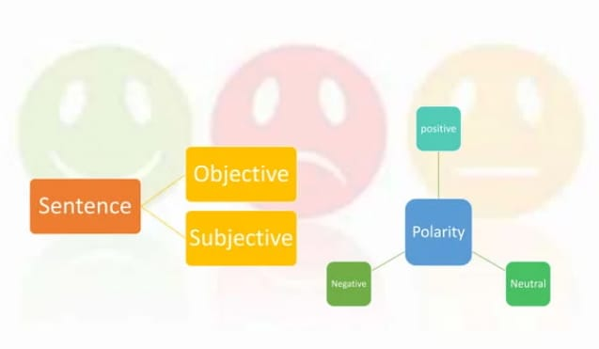
Sentiment analysis
Sentiment analysis (or opinion mining) is a natural language processing (NLP) technique used to determine whether data is positive, negative or neutral. Sentiment analysis is often performed on textual data to help businesses monitor brand and product sentiment in customer feedback, and understand customer needs.

Slide 6
Block diagram
Importing libraries
Input as String
Convert_to_df
Analyze_token_sentiment
Display result

Slide 7
LITERATURE SURVEY
S.NO | PAPER | PUBLISHER | YEAR | LEARNT
1 | Sentiment Analysis Approach using modified VADER | IEEE | 2019 | We learnt about Vader lexicon
2 | Sentiment Analysis using Feature Extraction and Dictionary based approach. | IEEE | 2019 | We learnt about panda dictionary
S.NO | PAPER | PUBLISHER | YEAR | LEARNT
1 | Assamese VADER:A Sentiment analysis using modified vader | IEEE | 2021
2 | Sentiment Analysis Approach using modified VADER. | IEEE | 2019
3 | Sentiment Analysis using Feature Extraction and Dictionary based approach. | IEEE | 2019

Slide 8
FLOWCHART
START
HOME PAGE
FORM SUBMISSION
SENTIMENT RESULT DISPLAY
EMOJI DISPLAY
DATAFRAME DISPLAY
END
VISUALISATION DISPLAY

Slide 9
libraries
TextBlob (from textblob):TextBlob is a Python library for processing textual data, built on top of NLTK (Natural Language Toolkit) and Pattern libraries. It provides a simple API to perform common NLP tasks like part-of-speech tagging, noun phrase extraction, sentiment analysis, classification, translation, and more. TextBlob is known for its ease of use and beginner-friendly syntax, making it a popular choice for quick NLP experimentation and prototyping.
pandas:pandas is a widely used open-source Python library that provides powerful data structures and data analysis tools. It is particularly well-suited for working with structured data, such as tabular or time-series data. pandas introduces two main data structures: Series (for 1-dimensional data) and DataFrame (for 2-dimensional data, resembling a table). It allows for efficient data manipulation, transformation, filtering, and cleaning. With pandas, you can perform various data operations like aggregation, grouping, merging, and visualization.

Slide 10
contd
altair:Altair is a Python library for declarative data visualization. It is built on top of Vega and Vega-Lite, which are visualization grammars for generating interactive visualizations. The library is designed to make it easier to create visually appealing and interactive charts and plots with concise and straightforward syntax. Altair provides a high-level abstraction, allowing users to create complex visualizations with minimal code.
SentimentIntensityAnalyzer (from vaderSentiment):SentimentIntensityAnalyzer is a part of the vaderSentiment library, which is specifically designed for sentiment analysis in text. It is a rule-based sentiment analysis tool that focuses on analyzing the sentiment of social media text, including Twitter data. The SentimentIntensityAnalyzer calculates a compound sentiment score for a given text, representing the overall sentiment as a single numerical value between -1 (most negative) and +1 (most positive).

Slide 11
Existing technology
Bag-of-Words (BoW):
1. Explanation: The Bag-of-Words model is a widely used approach in sentiment analysis that represents text documents as a collection of words. This paper proposes a method that applies the Bag-of-Words approach with feature selection based on minimum length and maximum frequency. The study demonstrates the effectiveness of this approach in text classification tasks, such as sentiment analysis.
2. Term Frequency-Inverse Document Frequency (TF-IDF): Explanation: TF-IDF is a popular feature extraction technique used in sentiment analysis. It assigns weights to words based on their frequency in a document (Term Frequency) and inversely proportional to their occurrence across the corpus (Inverse Document Frequency). This paper presents an improved method for text feature extraction using TF-IDF in sentiment analysis tasks, showcasing its effectiveness in capturing relevant features for sentiment classification.

Slide 12
Proposed technology
importing the necessary packages: streamlit, TextBlob from textblob, pandas, altair, and SentimentIntensityAnalyzer from vaderSentiment.
The convert_to_df function takes a sentiment object as input and converts it into a Pandas DataFrame.
The analyze_token_sentiment function performs token-level sentiment analysis using the VADER sentiment analyzer. It splits the input text into tokens, calculates sentiment scores for each token, and classifies them as positive, negative, or neutral based on a compound score threshold.

Slide 13
Contd..
The main function is the entry point of the application. It initializes the Streamlit app, sets the title to "Sentiment Analysis NLP App," and creates a sidebar menu with a single option ("Home").
If the user selects "Home" from the sidebar menu, the code displays the "Home" section. It creates a form using st.form with a text area for entering text and a submit button labeled "Analyze.“
If the submit button is clicked, the code executes the following steps:
The sentiment analysis is performed using TextBlob on the raw text entered by the user. The sentiment object is stored in the sentiment variable.
The sentiment object is displayed using st.write.

Slide 14
Contd..
An emoji is displayed based on the polarity of the sentiment: a smiley face for positive sentiment, an angry face for negative sentiment, and a neutral face for neutral sentiment.
The sentiment object is converted into a DataFrame using the convert_to_df function, and the DataFrame is displayed using st.dataframe.
A bar chart visualization of the sentiment metrics is created using Altair and displayed using st.altair_chart.
In the second column, the code displays the "Token Sentiment" section. It calls the analyze_token_sentiment function on the raw text entered by the user and displays the token-level sentiment analysis results using st.write.
If the user selects an option other than "Home" in the sidebar menu, the code displays the "About" section.

Slide 15
Contd..
Finally, the main function is called when the script is run as the main program.
To create a flowchart, you can represent the steps described above using flowchart symbols and connecting them with arrows to indicate the flow of control.

Slide 16
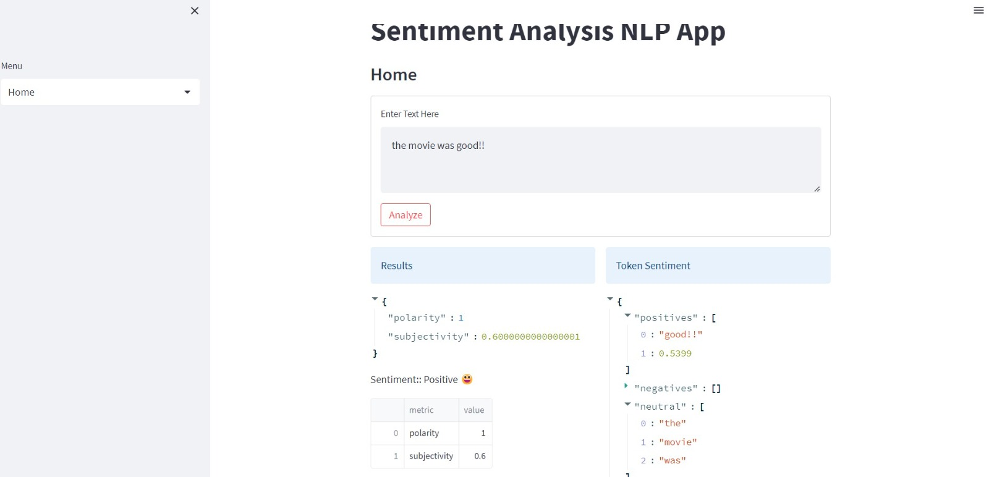
RESULT

Slide 17
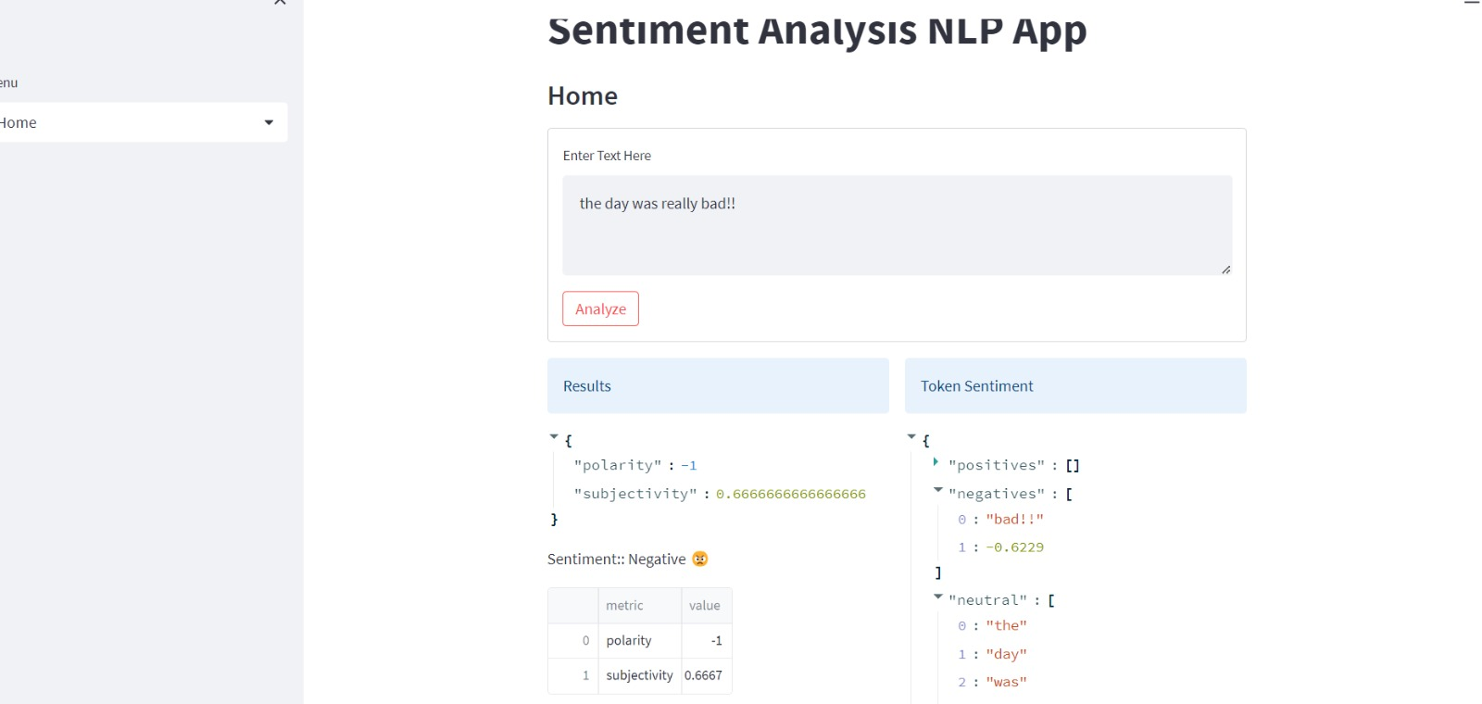
Contd..

Slide 18
conclusion
The sentiment analysis NLP app developed using Streamlit provides users with the ability to analyze the sentiment of a given text. The app utilizes the TextBlob library for sentiment analysis and the vaderSentiment library for token-level sentiment analysis. It offers a user-friendly interface for entering text and obtaining sentiment analysis results.

Slide 19
Future scope
Helping Human Resources
Future of Brand Monitoring
Sales Improvement

Slide 20
References
IEEE Papers
1. https://ieeexplore.ieee.org/document/9032456/
2.https://ieeexplore.ieee.org/document/8679144/

Slide 21
Thank You

